Slide 1

How to Sign Up for GroupMe
A step-by-step guide

Slide 2
Step 1: Download the GroupMe App
Download the GroupMe app from the App Store (iOS) or Google Play Store (Android).

Slide 3
Step 2: Open the App and Sign Up
Open the app and tap 'Sign Up'. You can sign up using your email, phone number, or log in with your Microsoft or Facebook account.

Slide 4
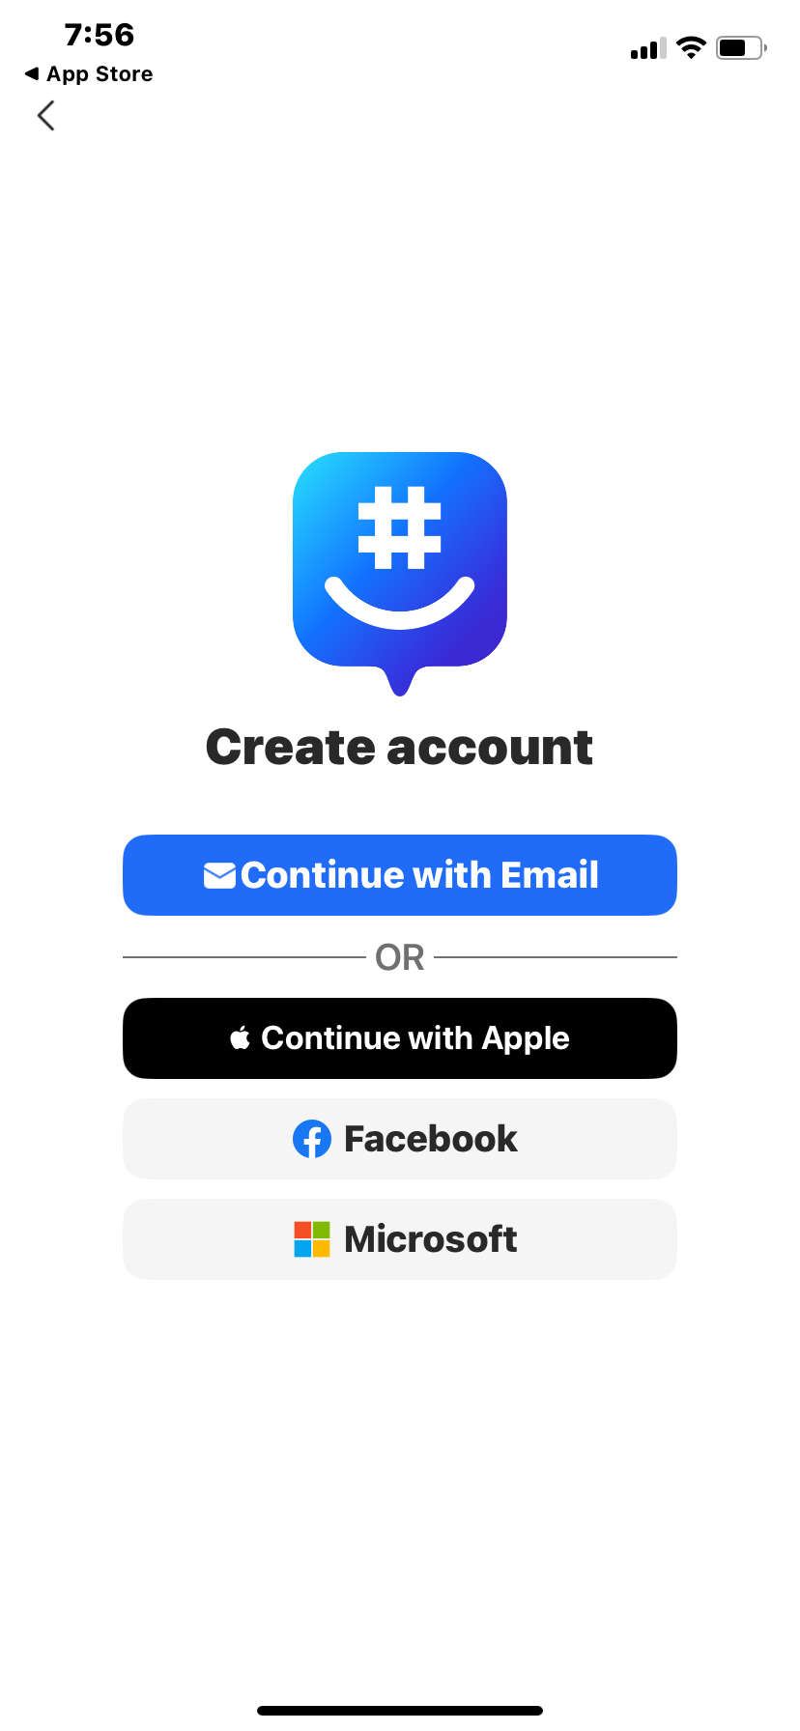
Sign Up

Slide 5
Step 3: Verify Your Account
Enter the verification code sent to your phone or email to complete the sign-up process.

Slide 6
Watch the Tutorial Video
Click the link below to watch the video tutorial:
https://youtu.be/NO5s8J5UWHg?si=BI26-jLrgCoYtTxL

Slide 7
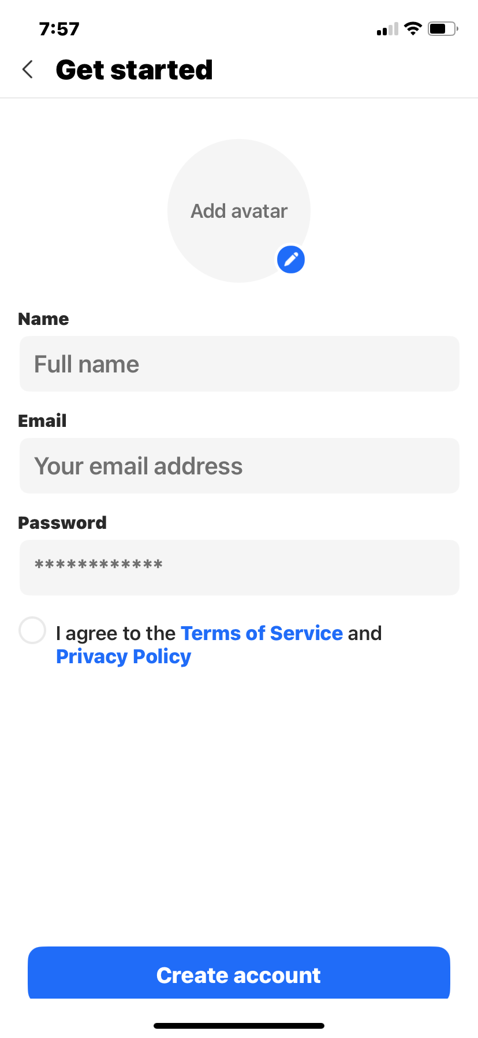
GroupMe

Slide 8
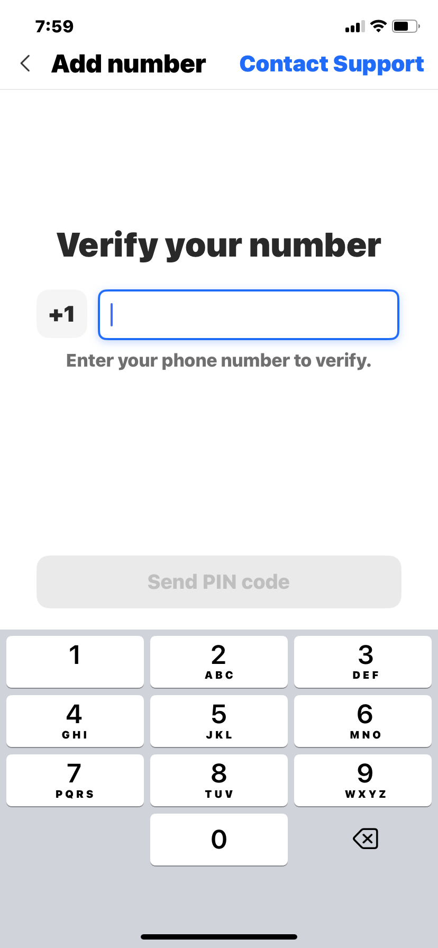
GroupMe

Slide 9
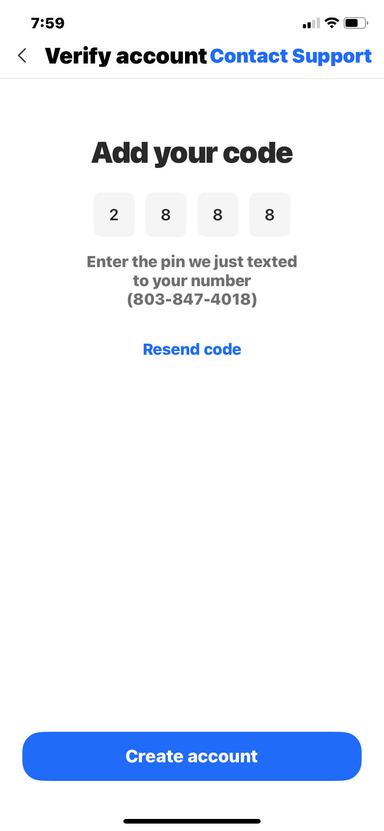




GroupMe

